Slide 1
SAS PROJECT WORLD ENERGY CONSUMPTION AND POPULATION

Slide 2
DATA SOURCE
WORLD ENERGY CONSUMPTION
https://www.kaggle.com/datasets/nirmalprasad/world-energy-consumption
WORLD POPULATION
https://data.worldbank.org/indicator/SP.POP.TOTL

Slide 3
PROBLEM DEFINITION AND EXPLANATION
To see if population and energy consumption are correlated.
To understand energy consumed per person (renewable/non-renewable) by country.
Notes:
In this project we wanted to know the correlation between energy consumption of the country and the population of the country. With high population we assumed that there would be more energy consumption about this we are disscuing more in further slides..
Through this we want to understand how much of the energy is consumed by each person form each country for renewable and non-renewable energy.

Slide 4
DATA CLEANING
Imported the data in SAS.
Checked and cleaned the data using proc sql codes.
To correct typos.
Selected top 20 most populated countries and created a table.
Deleted unwanted columns and country names.
Changed 0 to null.
Used functions like CREATE, UPDATE AND DELETE.
Notes:
We have cleaned this data and taken from 1995 – 2021 data for both energy consumption and population in this according to 2021 we have taken top 20 countries because for energy consumption data we don’t have few countries this we took for all the years and we have excluded few countries to match the energy consumption data and also we has removed few columns which are unused and also we had corrected few spellings.
we had changed the 0’s to null because while doing average 0 are also adding in average.
We had used create, update, delete functions to do this data cleaning.

Slide 5
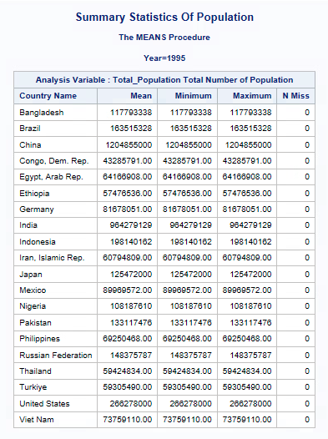
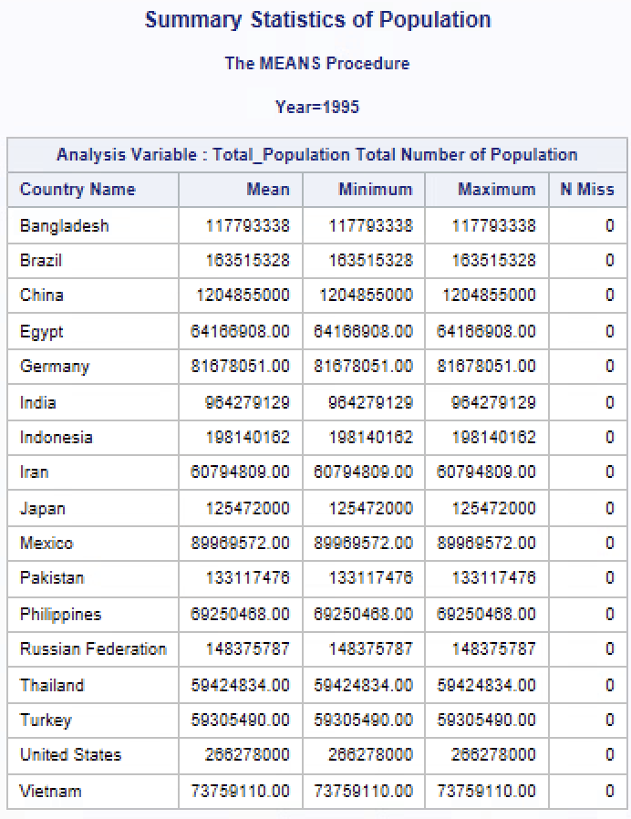
DATA VERIFICATION
Summary Statistics (pre-cleaned)
Summary Statistics (cleaned)

Slide 6
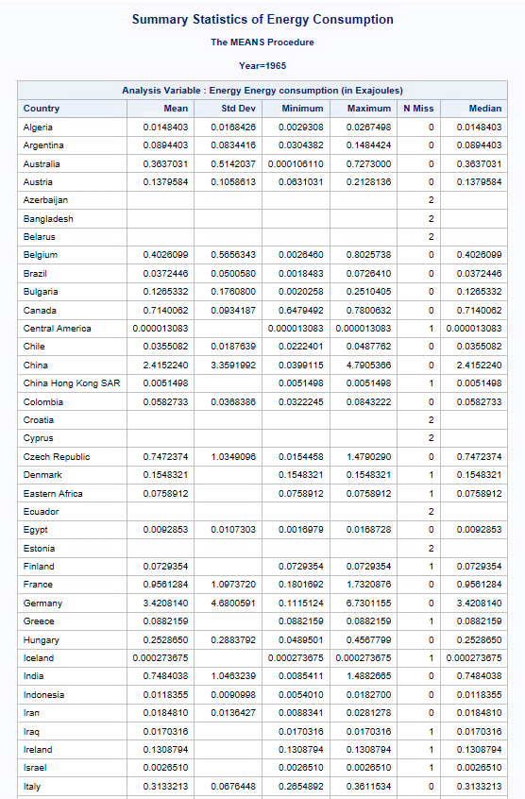
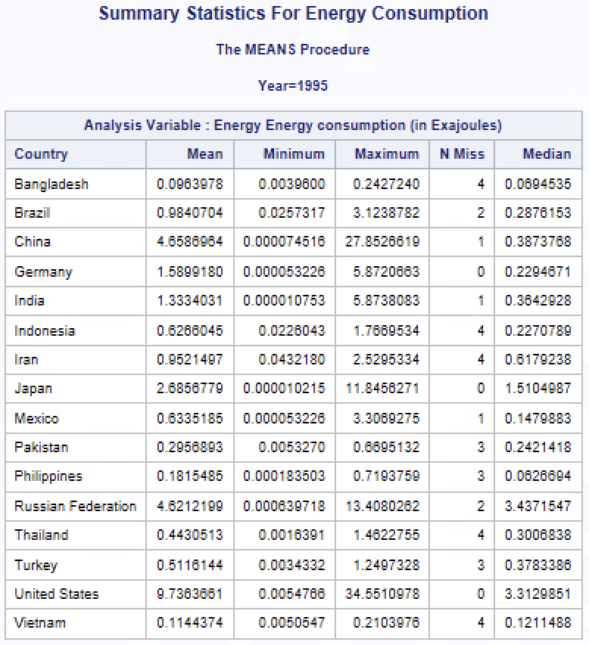
Summary Statistics (pre-cleaned)
Summary Statistics (cleaned)

Slide 7
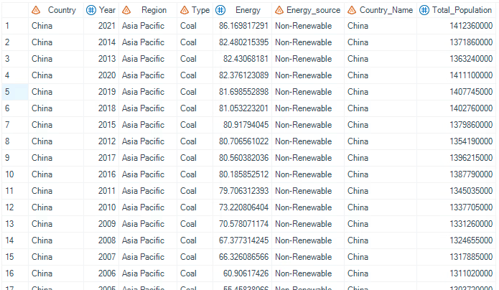
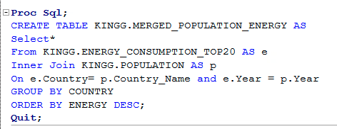
MERGING ENERGY CONSUMPTION AND POPULATION
Inner join of Energy Consumption and Population was used for further analysis.
Added a column named Energy_Source and categorized type of energy by (Renewable/Non-Renewable) e.g Coal-NR and Wind-R

Slide 8
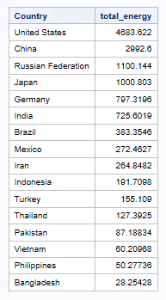
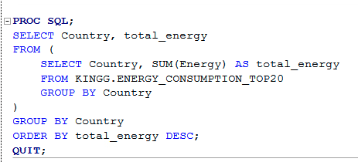
TOTAL ENERGY CONSUMED BY COUNTRY
United States tops the chart for the usage of overall energy resources.
Used subquery to get this output.

Slide 9
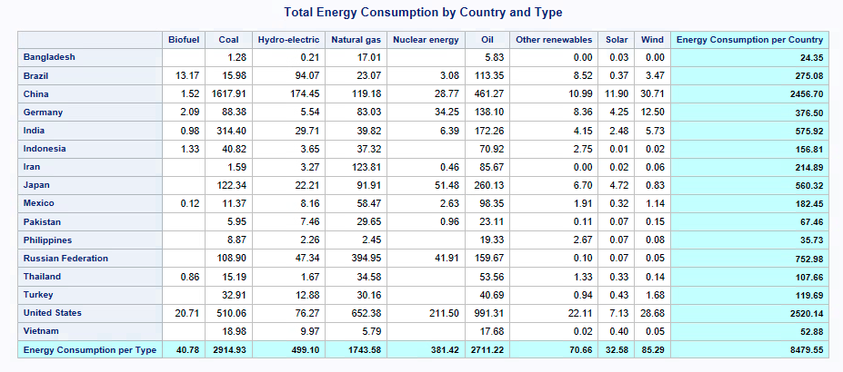

Slide 10
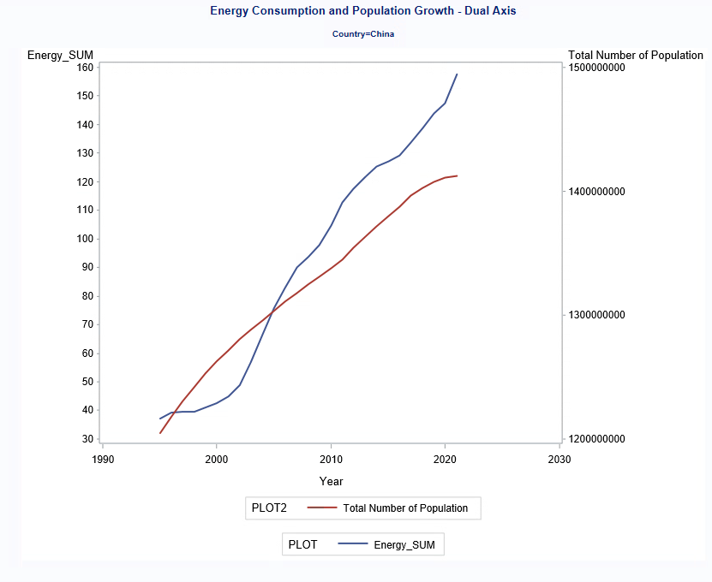
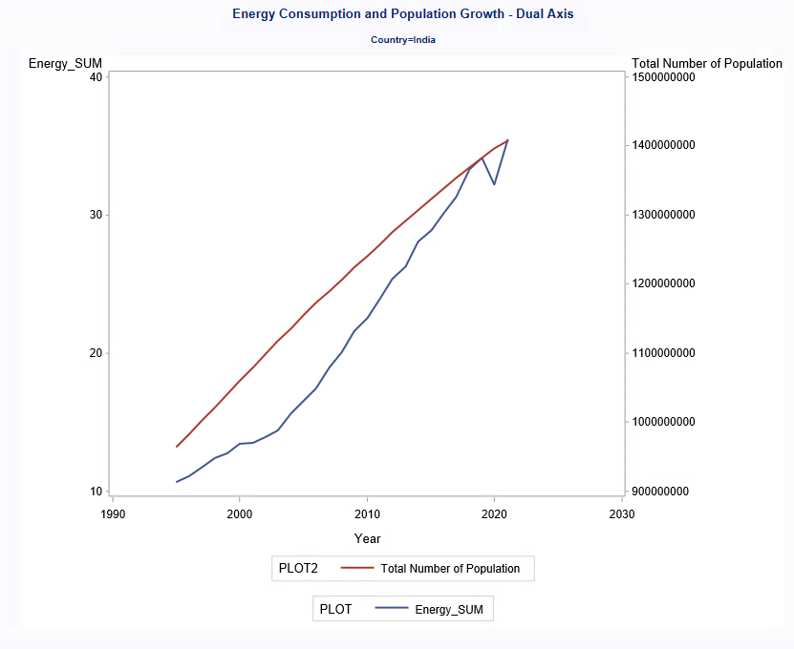
CORRELATION OF ENERGY CONSUMPTION AND POPULATION
Analysis for 1st problem definition:
Population and energy consumption were correlated for 13 countries i.e., 76.47% of the data.
Timeseries graphs indicate the same.

Slide 11
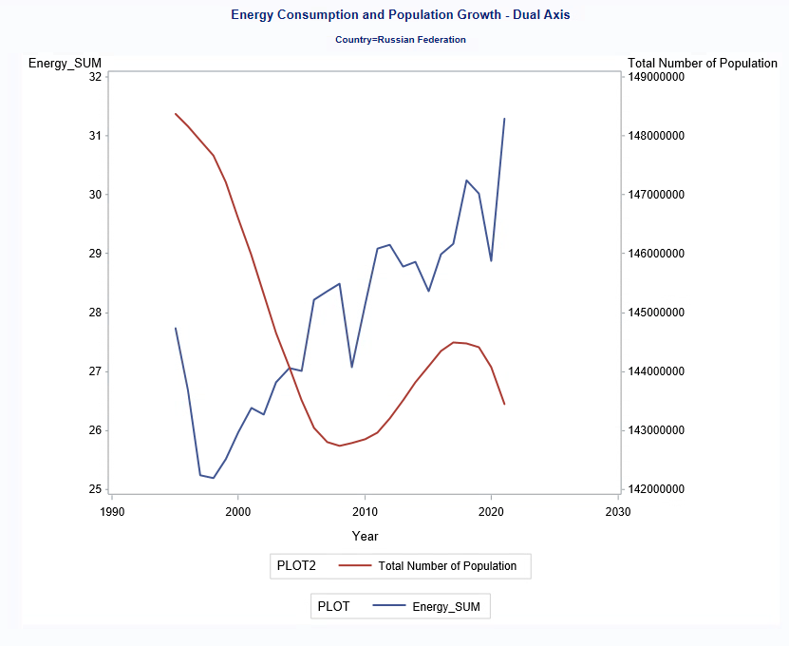
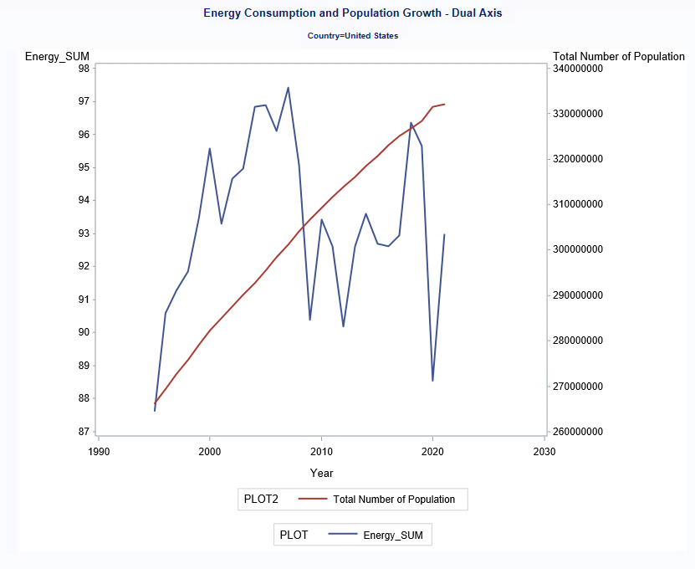
No correlation found between population and energy consumption for 4 countries i.e., 23.5% of the data.

Slide 12
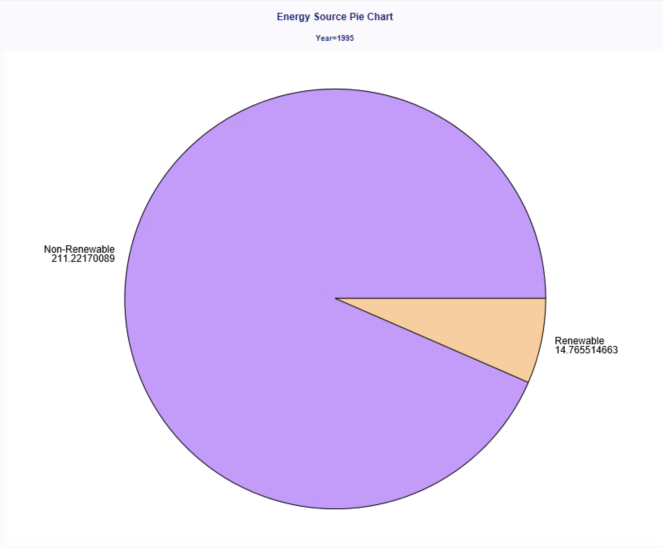
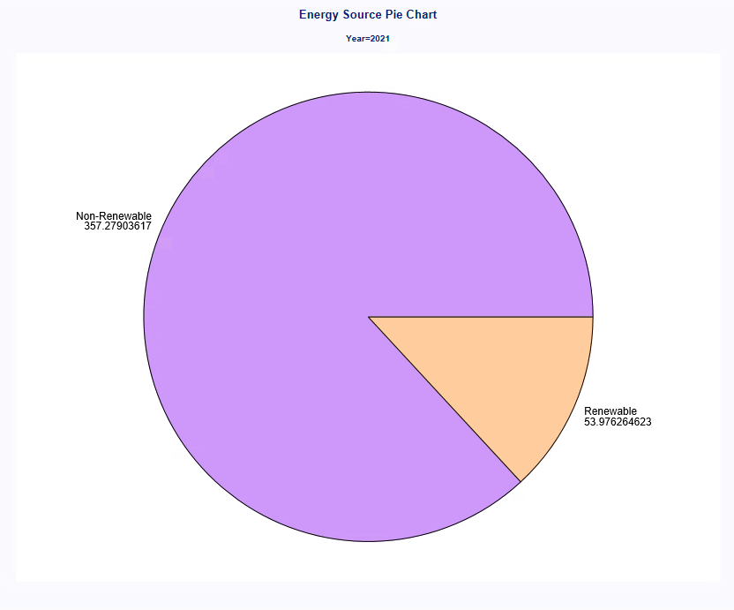
GRADUAL INCREASE OF RENEWABLE ENERGY CONSUMPTION FROM 1995 - 2021

Slide 13
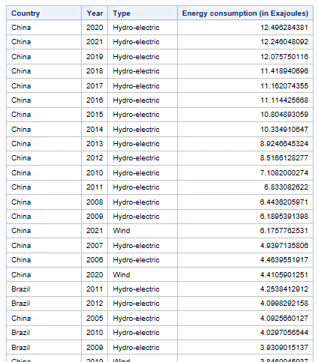
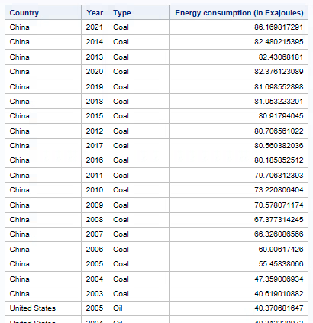
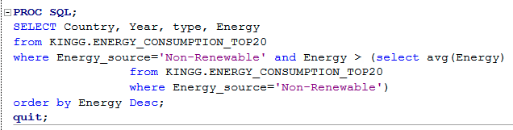
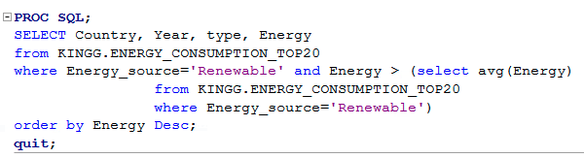
COUNTRIES ABOVE TOTAL TEMPORAL AVERAGE ENERGY CONSUMPTION
Output shows countries with years that surpass average energy usage (renewable and nonrenewable)
Used inline view.

Slide 14
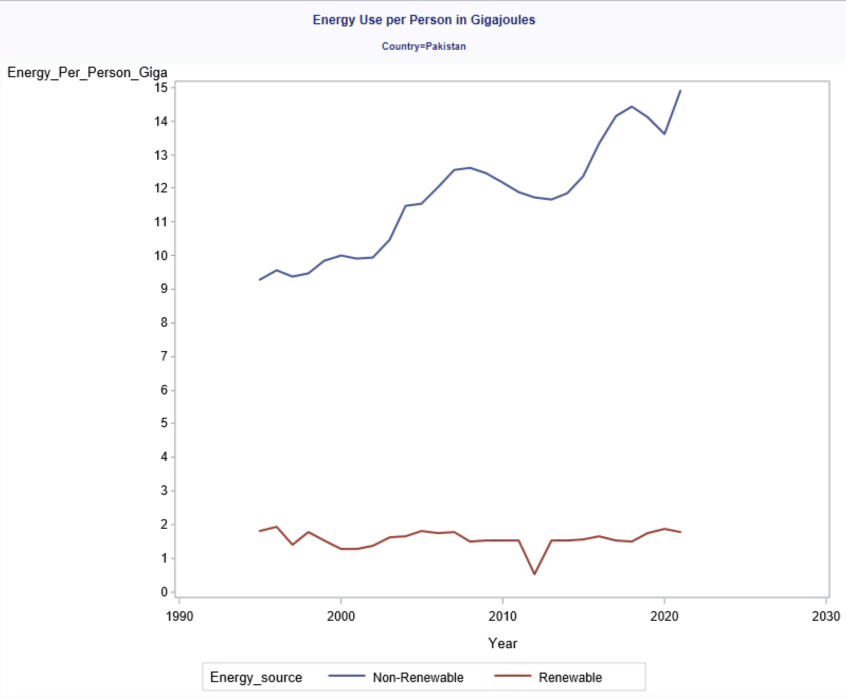
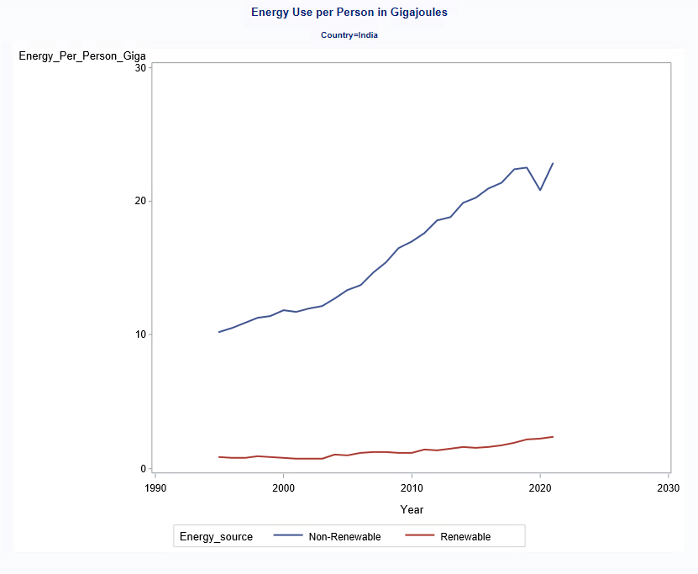
PER PERSON USAGE OF NON-RENEWABLE AND RENEWABLE ENERGY
An increase in non-renewable energy is seen but very slow to no growth in renewable per-person energy usage.
This trend is observed for 13 countries i.e; 76.47% of overall data.

Slide 15
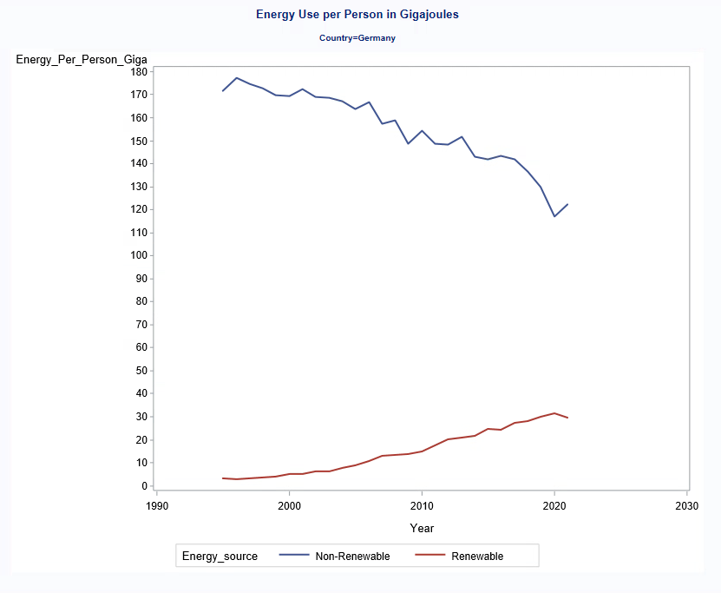
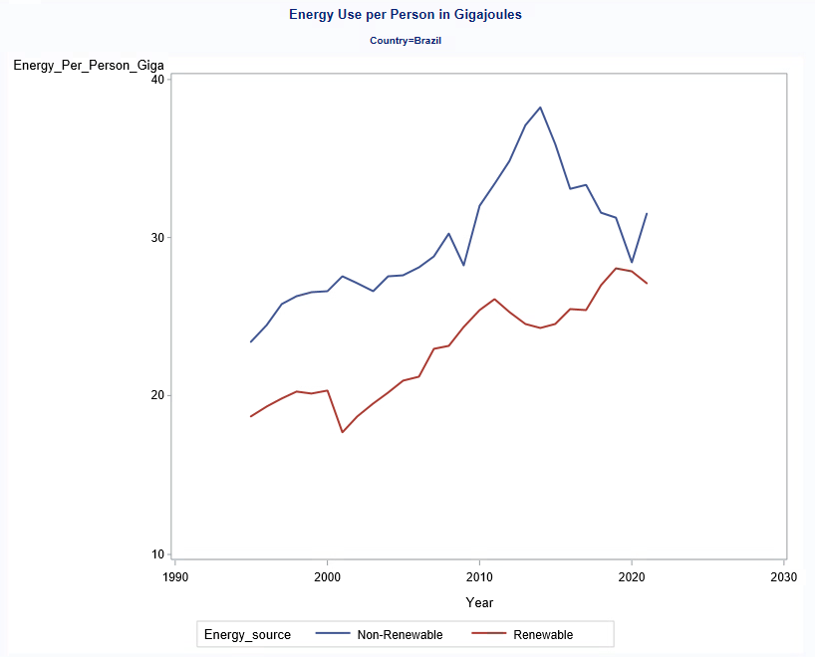
A gradual decrease in non-renewable resource usage while renewable resource usage is increasing. This trend is observed for 4 countries i.e; 23.53% of overall data.

Slide 16
CONCLUSION
To see if population and energy consumption are correlated.
76.47% indicates correlation
23.53% indicates lack of correlation
To understand energy consumed per person (renewable/non-renewable) by country.
76.47% indicates increasing non-renewable energy usage while renewable energy usage runs constant
23.53% indicates declining non-renewable energy usage while renewable energy usage increases

Slide 17
RECOMMENDATIONS
For more in-depth research, all countries can be considered from both datasets instead of just 17 countries
New variable for clean energy can be added (renewable energy does not always mean clean energy)

Slide 18


